Slide 1
Types of machine learning

Slide 2
Expand Feature and Label
Feature : In machine learning and pattern recognition , a feature is an individual measurable property or characteristic of a phenomenon. Choosing
informative, discriminating and independent features is a crucial element of
effective algorithms in pattern recognition, classification and regression .
Features are usually numeric , but structural features such as strings and
graphs are used in syntactic pattern recognition ..
The concept of feature is related to that of explanatory variable used in statistical techniques such as Linear Regression.

Slide 3
Label : The output you get from your model after training it is called a label.
In machine learning, data labeling is the process of identifying raw data (images, text files, videos, etc.) and adding one or more meaningful and informative labels to provide context so that a machine learning model can learn from it.

Slide 4
Training Dataset and Testing Dataset
Training Dataset : The “training” data set is the general term for the samples used to create the model, while the “test” or “validation” data set is used to qualify performance. Perhaps traditionally the dataset used to evaluate the final model performance is called the “test set”.
The sample of data used to fit the model.

Slide 5
Testing Dataset: The sample of data used to provide an unbiased evaluation of a final model fit on the training dataset.
The Testing dataset provides the gold standard used to evaluate the model. It is only used once a model is completely trained.
Many a times the validation set is used as the testing set, but it is not good practice.
The testing set is generally well curated. It contains carefully sampled data that spans the various classes that the model would face, when used in the real world.

Slide 6
Types of Machine Learning
Supervised Learning
Unsupervised Learning
Reinforcement

Slide 7
SUPERVISED LEARNING
Supervised learning is the process of providing input data as well as correct output data to the machine learning model.(The aim of
a supervised learning algorithm is to find a mapping function
to map the input (x) with the output variable (y).
Basically supervised learning is when we teach or train the machine using data that is well labeled. Which means some data
is already tagged with the correct answer . After data provide a
new set of example .so this algorithm analysis the training data
produce a outcome from labeled data .

Slide 8
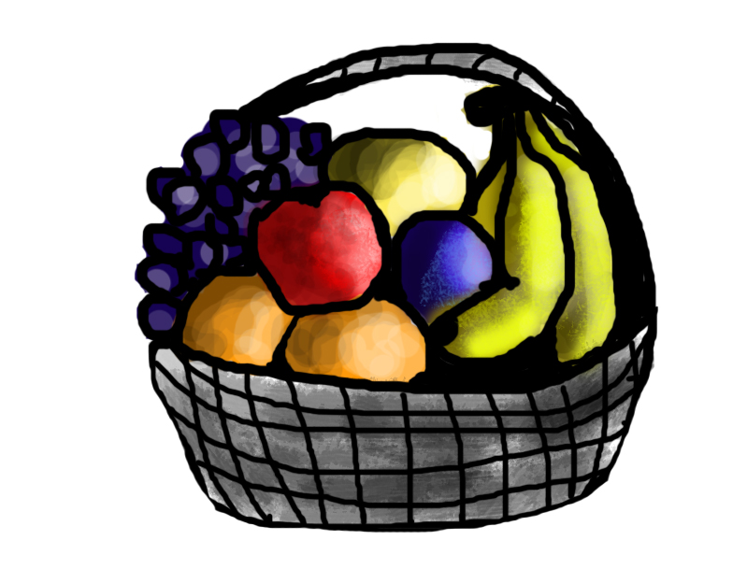
Example for supervised learning :
Suppose you are given a basket filled with different kinds of fruits. Now the first step is to train the machine with all different fruits one by one like this
If the shape of the object is rounded and has a depression at the top , is chocolate in color, then it will be labeled as – Chikoo.
If the shape of the object is long curving cylinder having green-yellow color, then it will be labeled as -Banana .

Slide 9

Now suppose after training the data , you have given a new separate fruit , say Banana from the basket, and asked to identify it .

Slide 10
Types of Supervised Learning
Classification : A classification problem is when the output
variable is a category, such as “red” or “blue” and “disease”
or “no disease”.
Regression: A regression problem is when the output variable is
a real value, such as “dollars” or “weight” .

Slide 11
Algorithm used in Classification
Support Vector Machine (SVM)
Decision Trees
Logistic Regression
Naïve Bayes
Random Forests
K nearest Neighbor

Slide 12
Algorithm used in Regression
Linear regression
Polynomial Regression
Support Vector Machine
Decision Tree
Random Forest Regression
KNN
Naïve Bayes

Slide 13
Unsupervised Learning
Here we provide a unlabel data and classification of emails into spam and not spam .
Here output is unknown (unlike in supervised learning output is known)
It tries to make a sense unlabeled data extracting features co – occarance and underlined pattern on its own.
There is no label associated with this learning In unsupervised learning the
machine this to find interesting patterns in the data .

Slide 14
Difference between supervised and unsupervised learning
Supervised Learning | Unsupervised Learning
Supervised learning algorithms are trained using labeled data . | Unsupervised learning algorithms are trained using unlabeled data.
This model takes direct feedback to check if it is predicting correct output or not. | Unsupervised learning model does not take any feedback .
This model predicts the output. | This model finds the hidden patterns in data.
In this input data is provided to the model along with the output . | In this only input data is provided to the model .

Slide 15
Types of Unsupervised Learning
Clustering
Association
Clustering : Clustering is a method of grouping the objects into clusters such that objects with most similarities remains into group and has less or no similarities with the objects of another group .
Association :An association rule is an unsupervised learning method which is used for finding the relationships between variables in the large database .

Slide 16
Reinforcement Learning
Reinforcement learning is the training of machine learning models to make a sequence of decisions . It is employed by
various software and machines to find the possible behavior or path it should take in a specific situation.
Reinforcement learning differs from supervised learning in a way that in supervised learning the training data has the answer key with it so the model is trained with the correct answer itself whereas in reinforcement learning .

